Slide 1

Course: Machine Learning
Chapter 1: Introduction
By: Dr. Muhammad Fayaz
Department of Computer Science, University of Central Asia

Slide 2
Marks Distribution
Item | Weight
Mid Term Exam | 20
Final Term Exam | 30
Assignments | 20
Quizzes | 20
Class Activities/Attendance | 10
Total | 100%

Slide 3
Teaching Strategy
Theory
Mathematical Solutions
Implementation

Slide 4
Machine Learning
Machine learning (ML) is the study of computer algorithms that improve automatically through experience.
It is seen as a subset of artificial intelligence.
Machine learning algorithms build a mathematical model based on sample data, known as "training data", in order to make predictions or decisions without being explicitly programmed to do so.

Slide 5

Applications of Machine Learning
2. Biomedical / Biometrics
Medicine:
Screening
Diagnosis
Drug Recommendation
Brain diseases detection
Lung Cancer Detection, etc.
Security:
Face recognition
Signature / fingerprint / iris verification
DNA recognition

Slide 6
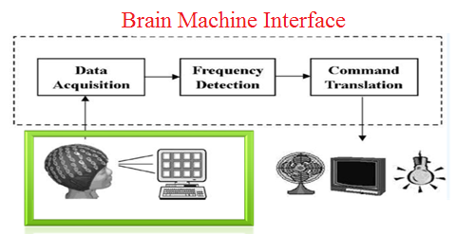
Applications of Machine Learning
3. Computer / Internet
Computer interfaces:
Troubleshooting wizards
Handwriting and speech
Brain waves
Internet
Spam filtering
Text categorization
Text translation
Recommendation

Slide 7
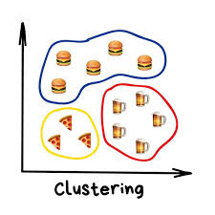
Types of Problems
Classification: Target(dependent) variable is categorical
Example: Gender Classification , Disease's classification, etc.
Regression: Target (dependent) variable is continuous/discrete
Example: Weight, Price
Optimization: Optimization is the process of finding the best solution in all feasible solutions.
Example: Shortest Path, etc.
Clustering: Clustering is the task of dividing the population or data points into a number of groups such that data points in the same groups are more similar to other data points in the same group and dissimilar to the data points in other groups.

Slide 8
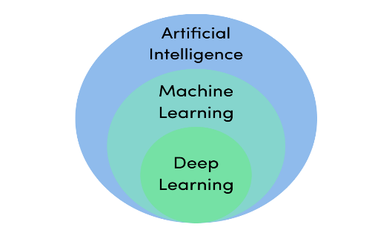
Artificial Intelligence
Evolutionary Intelligence
Supervised Learning
Swarm Intelligence
Unsupervised Learning
Fuzzy Systems
Semi-supervised Learning
Neural Network
Re-enforcement Learning
Probabilistic Techniques
Machine Learning
Classification/
Regression
Optimization
Clustering/
Association
Defining Uncertainty
Classification/Regression
Clustering
Classification/
Regression
Classification/Regression
Control
Deep Learning
Note: The Figure may have some minor inaccuracy

Slide 9
Evolutionary Intelligence (EI)
Swarm Intelligence (SI)
Artificial Neural Network (ANN)
Probabilistic Techniques
Genetic Algorithm (GA)
Particles Swarm Optimization (PSO)
Feed forward Neural Network (FFNN)
Logistic Regression
Genetic Programming (GP)
Ant Colony Optimization (ACO)
Recurrent Neural Network (RNN)
Naïve Bayes
Evolutionary Programming (EP)
Artificial Bee Colony (ABC)
Multi-layer Perceptron (MLP)
Decision Tree
Evolutionary Strategies (ES)
Bat Algorithm
Radial Basis Functional Network
Differential Equations (DE)
Fruit fly Algorithm
Modular Neural Network
Cultural Evolution
Firefly Algorithm
Convolutional Neural Network
Co-Evolution
Grey wolf Optimization (GWO)
Cohonen Self Organization Network

Slide 10
Supervised Learning
Unsupervised Learning
Semi Supervised Learning
Re-enforcement Learning
Artificial Neural Network
Centroid Based Clustering
Continuity assumption
Q-Learning
Logistic Regression
Density Based Clustering
Cluster Assumption
SARSA
K-Nearest Neighbors (KNN)
Distribution Based Clustering
Manifold Assumption
Deep Q Network
Support Vector Machine (SVM)
Hierarchical Clustering
Generative Models
Deep Deterministic Policy Gradient
Support Vector Regression (SVR)
Apriori Algorithm
Low density separation
Naïve Bayes
Equivalence Class Transformation (Eclat)
Graph based methods
Classification and Regression Tree
FP-Growth (Frequency Pattern)
Heuristic approaches
Random Forest

Slide 11
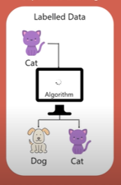
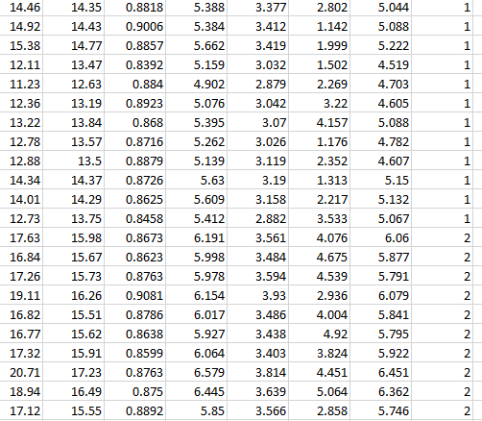
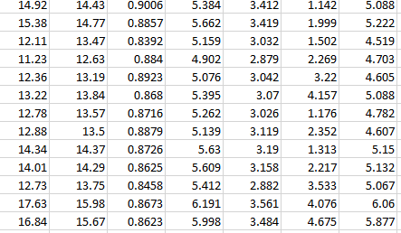
Basic Concepts
Input Data /features
Output Data/Labels
Labelled Data/Training Data: In the labelled data/training data we have inputs and corresponding outputs of the inputs
The training data are used to train the machine learning algorithm.
In the training process we give the inputs to the machine and then tell the machine that these are the outputs of the corresponding inputs
In this way the machine learning algorithm learns and then
Testing Data: In the testing data we have only inputs data and the output data or labelled are missing.
We only feed input data to the machine learning alroithm and the machine learning algorithm provides the predicted/estimated output based on the input data.
Real Output/
Actual Output

Slide 12
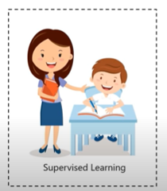
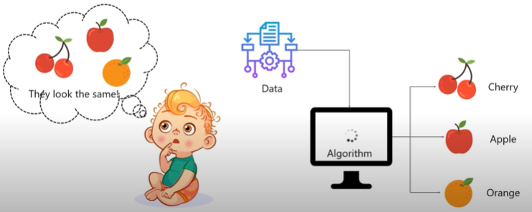
Supervised Learning Algorithm
Input Data /features
Outputs /Labels
In this case machine learns under guidance
As in the school, teacher guide us and taught us
In the supervised learning machine learns by feeding labelled data
And explicitly telling that this is the input, and this is exactly how the output must look.

Slide 13
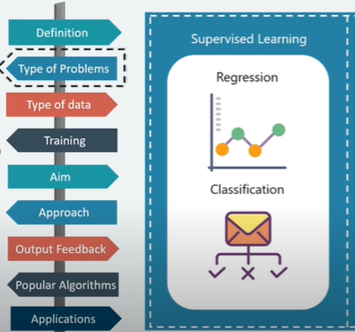
Supervised Learning Algorithm
Supervised Learning algorithms are normally use for regression or classification purposes as illustrated in the below Figure.

Slide 14
Thanks

